Slide 1

Google Playstore Data Analysis With Pyspark
Submitted by:
Manan Hasmukhbhai Patel
(885226993)
Jeet Ghodasara
(885867226)
Prof: TSENG-CHING JAMES SHEN

Slide 2

Introduction
One of the best selections of mobile applications is the Google Play Store, which offers millions of programs to billions of users worldwide.
To find out more about user preferences, market trends, and app performance, one can access a wealth of data that is concealed within this massive ecosystem.
To make sense of this data and extract crucial information, data analysis tools like PySpark are employed.
PySpark is an Apache Spark framework-interfacing Python module that is a powerful tool for processing large datasets in a distributed and parallelized manner.
It refers to the process of examining, transforming, and analyzing the substantial dataset that was downloaded from the Google Play Store in this particular instance using PySpark.

Slide 3
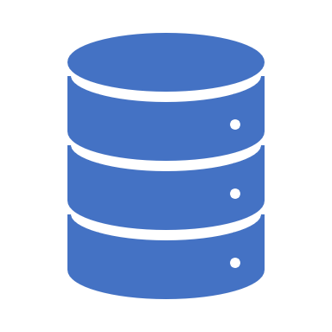
Proposed Solution
Utilizing Python's PySpark framework, the project aims to do a thorough data analysis of Google Play Store information.
Using the Google Play Store data in the Kaggle csv file, the project aims to obtain valuable insights on total installs, number of reviews, ratings, and price.
Creating a Microsoft Azure cluster using DataBricks and compute the data.
Storing large amount of data on Distributed File System on DataBricks.
Using PySpark, Cleaning, Analyzing, and Developing a Machine Learning Model in a distributed architecture that can process and analyze enormous amounts of data.
Using Matplotlib, Seaborn libraries to perform analysis. Making a regression model that predicts the number of installs per price.

Slide 4
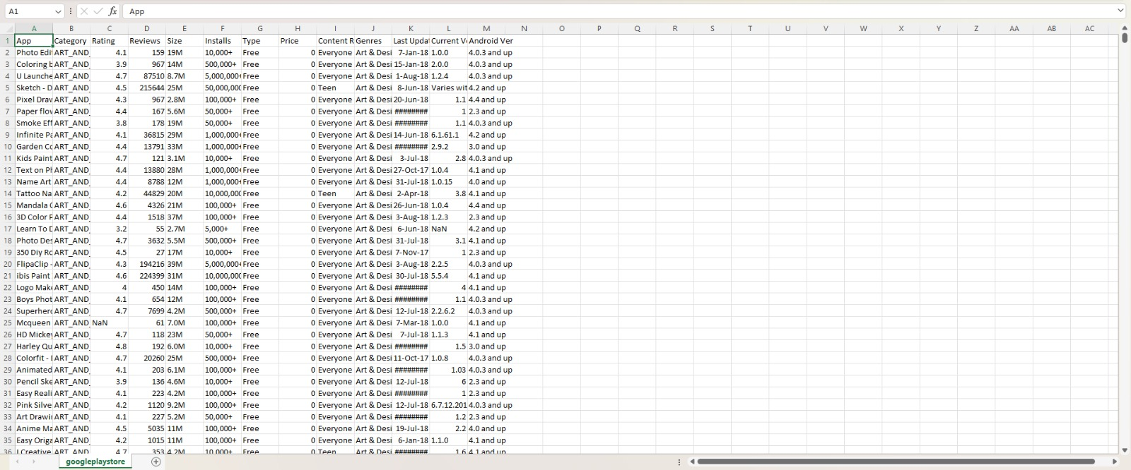
Google Playstore CSV File

Slide 5
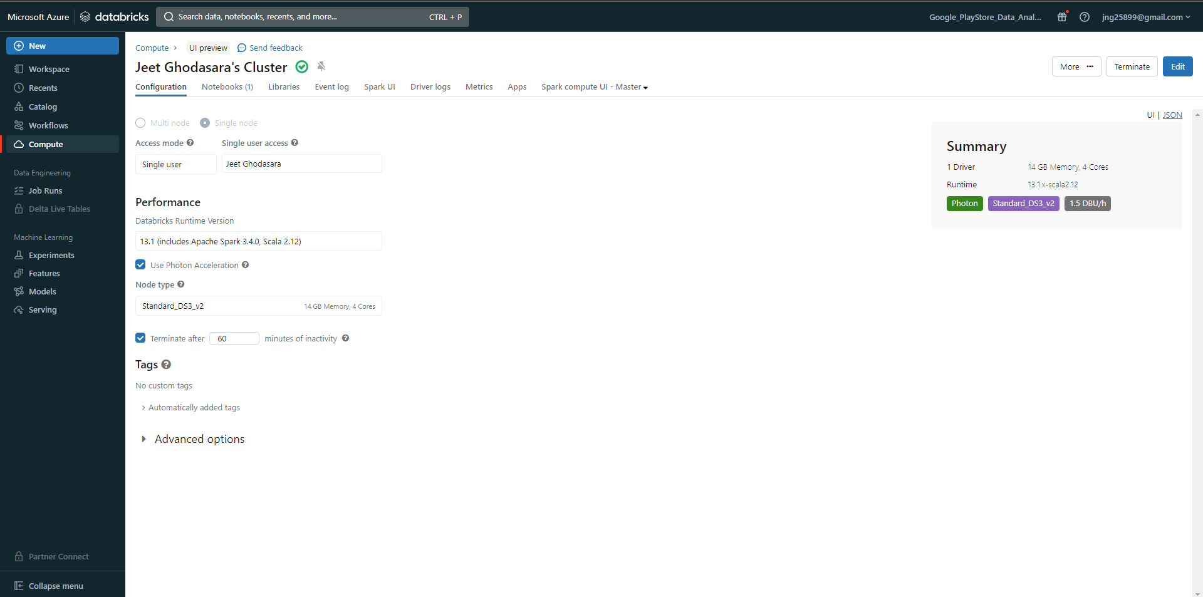
Cluster Creation in Azure

Slide 6
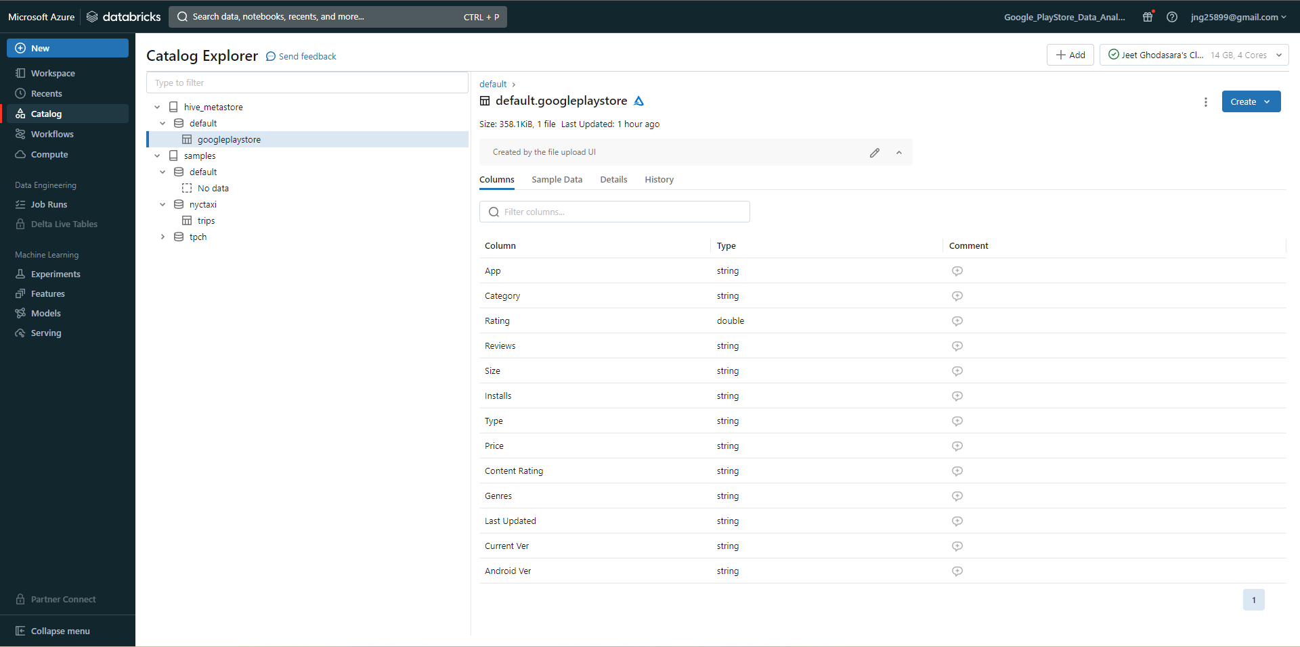
Making a table from the given CSV file

Slide 7
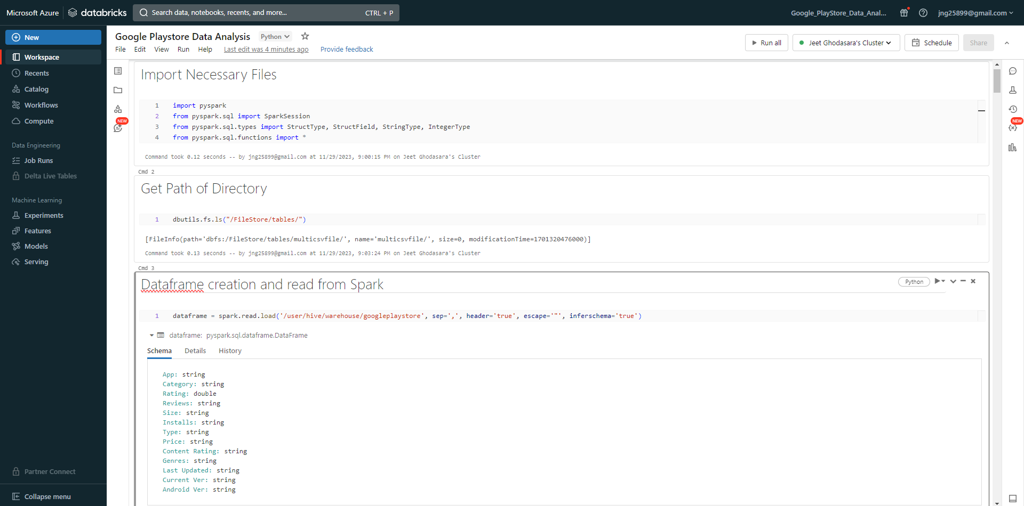
Creating a Spark Session and Dataframe

Slide 8
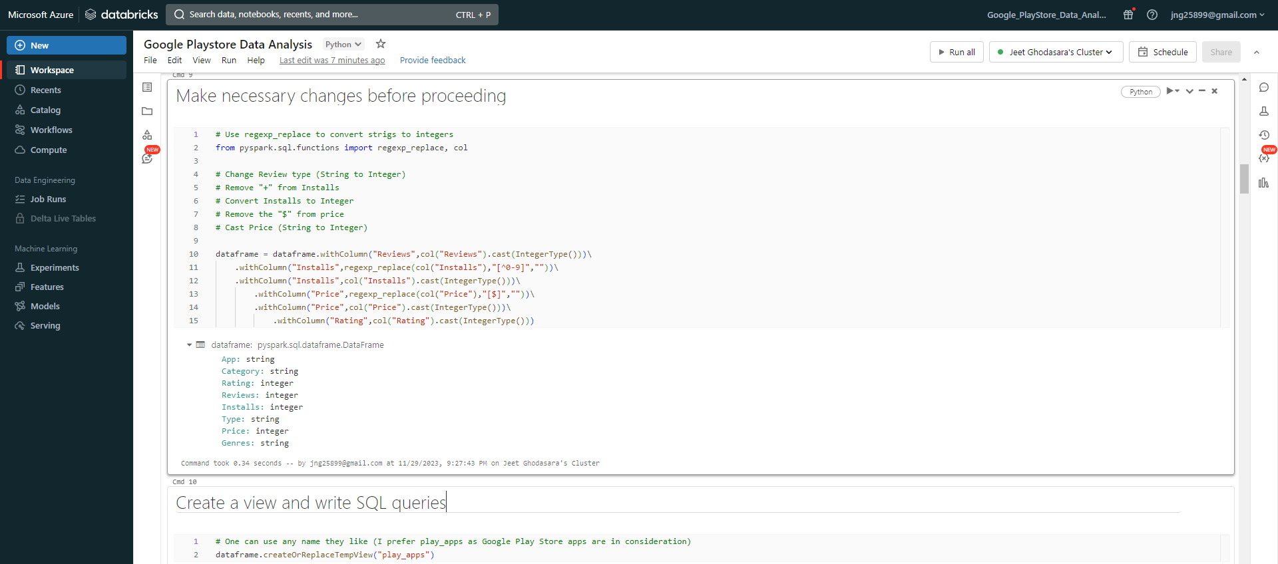
Data Cleaning and Transformation

Slide 9
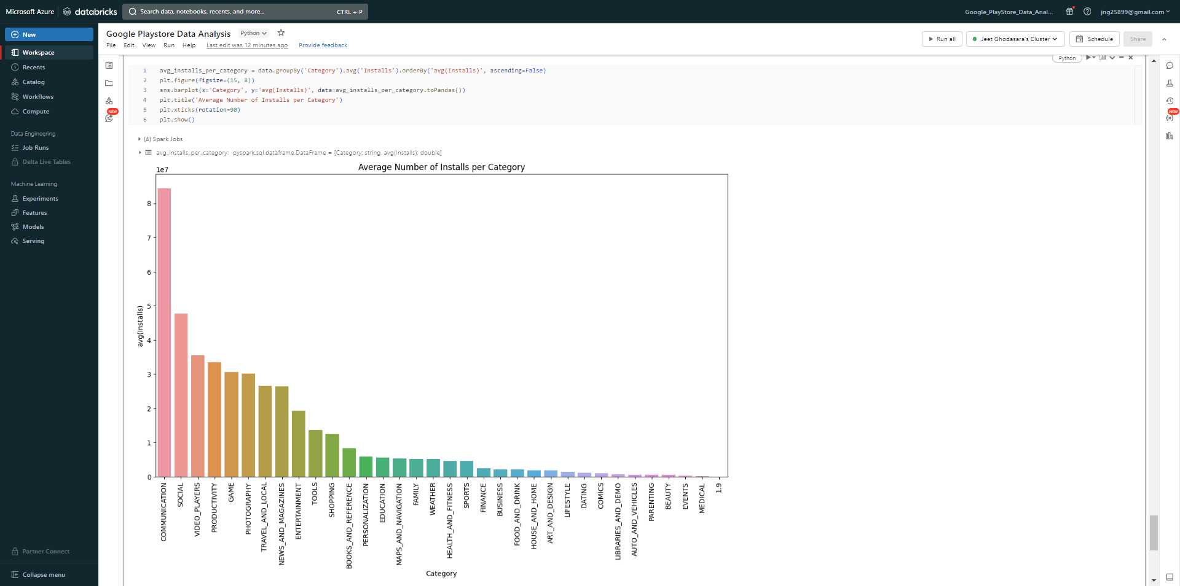
Installs per Categories

Slide 10
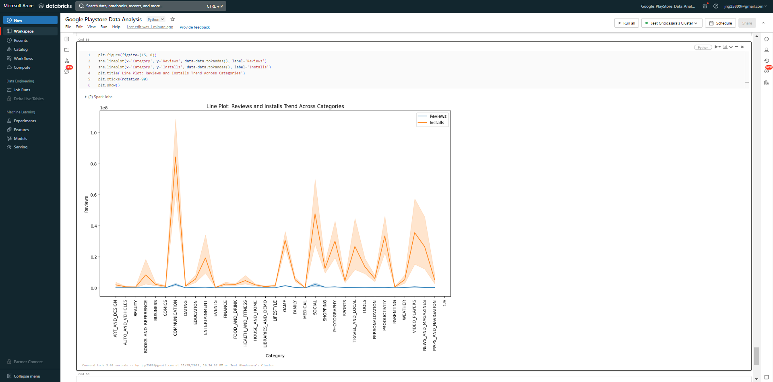
Number of Reviews and Installs across Categories

Slide 11
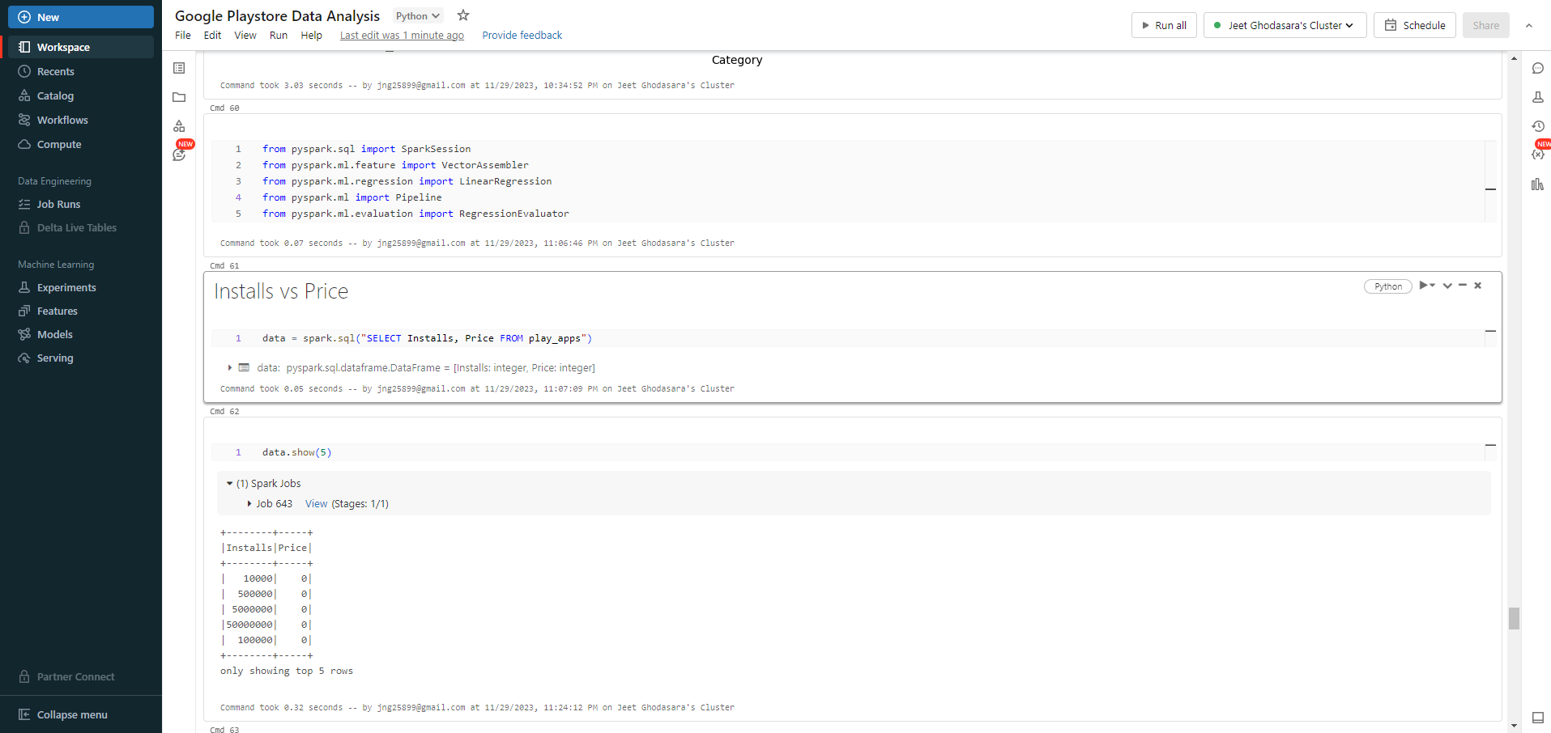
Installs vs Price prediction model

Slide 12
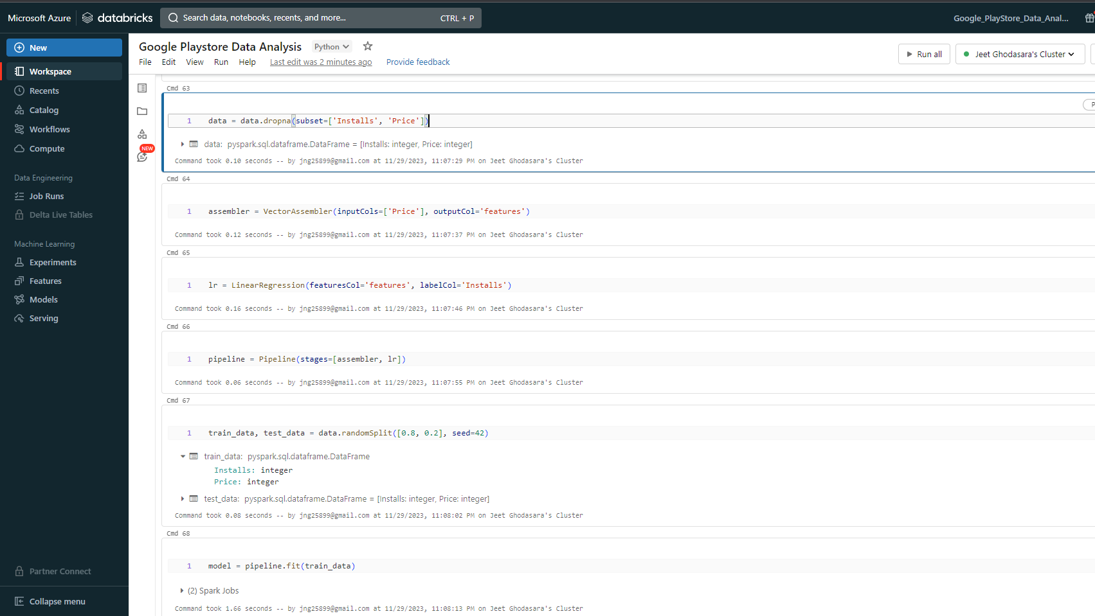

Slide 13
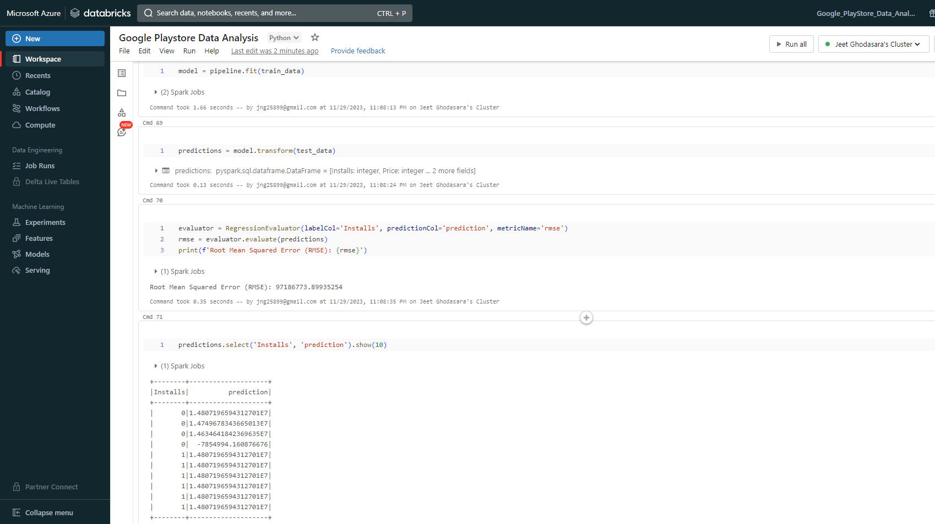

Slide 14
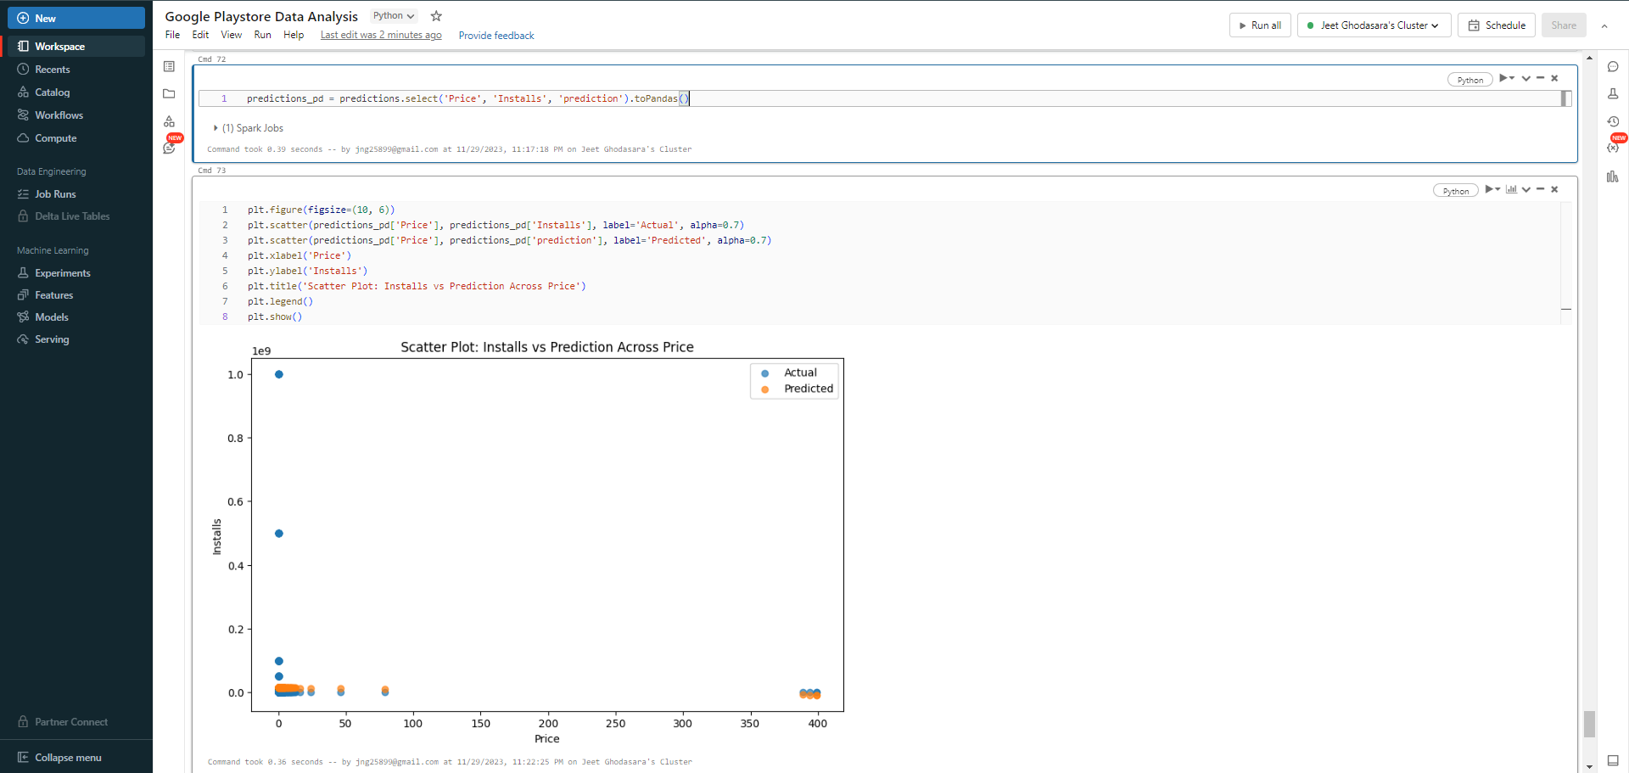
Installs vs Price prediction model (Visualized)

Slide 15
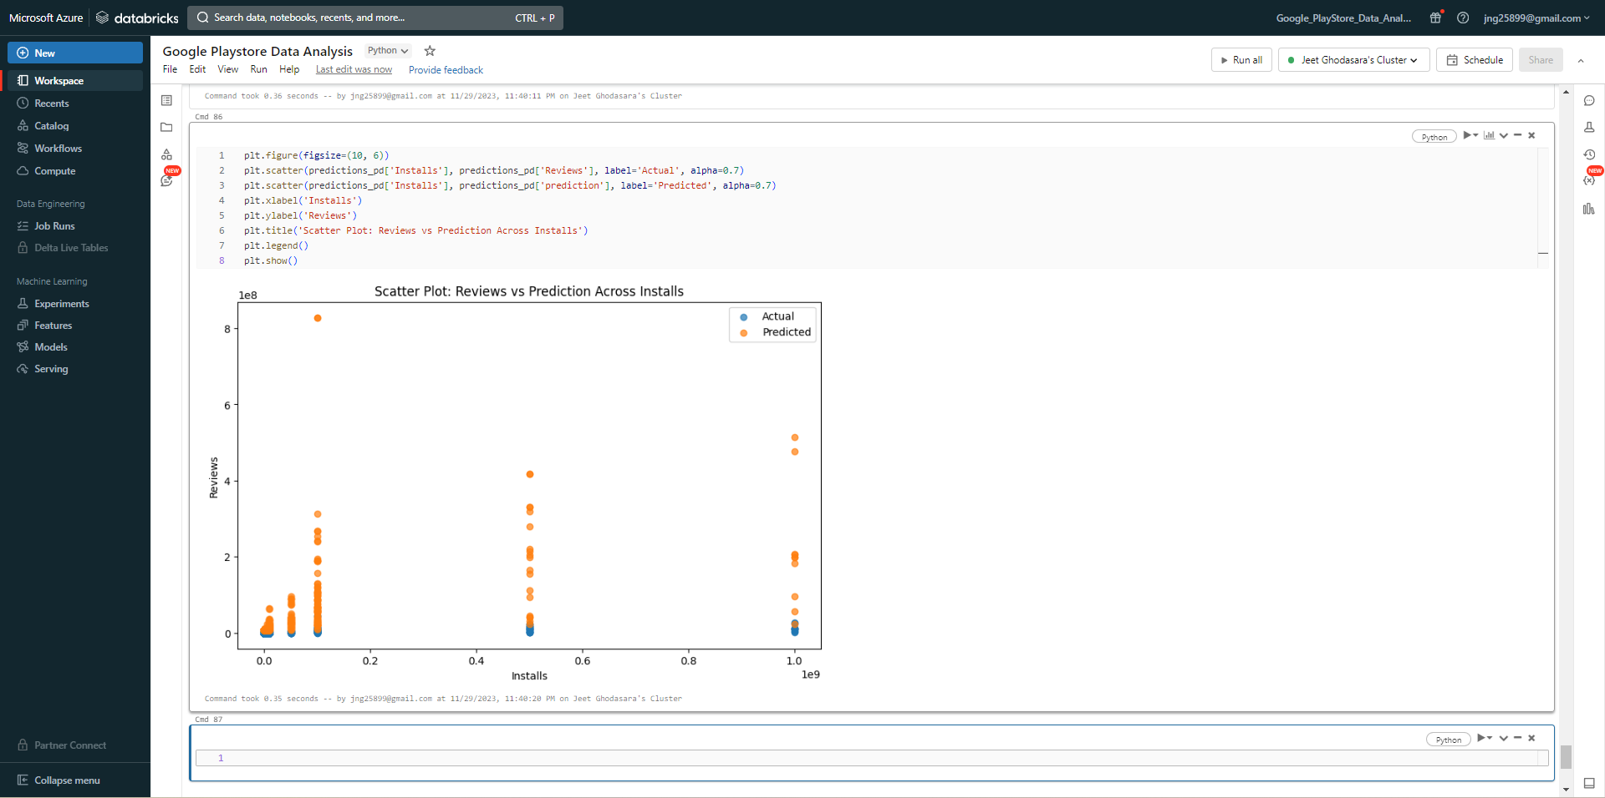
Reviews vs Price prediction model (Visualized)

Slide 16
Tools and Technologies used
Languages Used: Python
Cloud Platform: DataBricks
Cluster: Microsoft Azure Cluster
Storage: DataBricks DBFS
Machine Learning: PySpark
Libraries: Matplotlib, Seaborn, LinearRegression, VectorAssembler

Slide 17

Conclusion
Comprehensive Data Analysis: We performed a comprehensive analysis of Google Play Store data using PySpark on a distributed architecture, and we learned a lot about important parameters including the total installs, reviews, ratings, and price.
Efficient Distributed Computing: We were able to process and analyze massive amounts of data quickly and effectively because to the robust computing environment that the Microsoft Azure cluster on DataBricks offered. DataBricks' distributed file system made it easy to store and retrieve large amounts of data.
Insightful Visualizations: Our comprehension of the data trends was improved by the intelligent visuals we created using the Matplotlib and Seaborn packages. Stakeholders were assisted in making decisions by the clear and understandable communication of intricate findings through visualizations.
Predictive Modeling for Installs and Price: Based on price data, our PySpark-developed machine learning model accurately forecasted the number of installs. Regression modeling is a useful technique for pricing strategy optimization and app performance forecasts.

Slide 18
Any Questions??
Thank You!!

